Slide 1



01
Movement 1:
Individual Diagnostic
1:1 Meeting with Adriana Machado
My Name is ….. and I began my journey …
(include your individual quest here)
Spring
July 2026
Cohort
Date

Slide 2

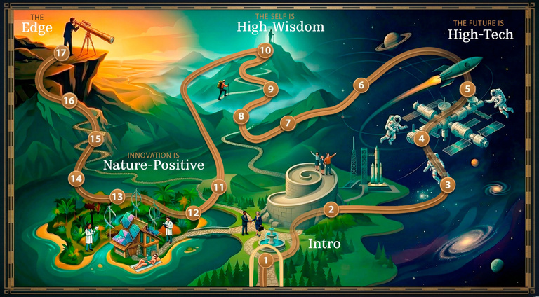

02
Movement 2:
The Track On Demand
Cycle 1
In Cycle of Reflection 1,
Igniting leaders for transformation,
my insights were:

Slide 3

02
Movement 2:
The Track On Demand
Cycle 2
In Cycle of Reflection 2,
The Future of Humanity, my insights were:

Slide 4
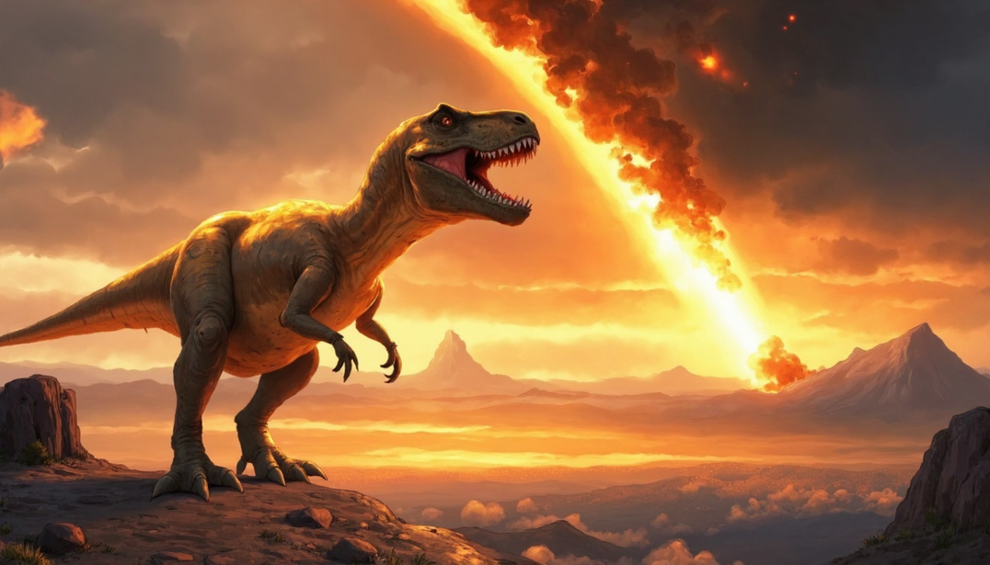
02
Movement 2:
The Track On Demand
Cycle 3
In Cycle of Reflection 3,
Disrupt or Be Disrupted, my insights were:

Slide 5
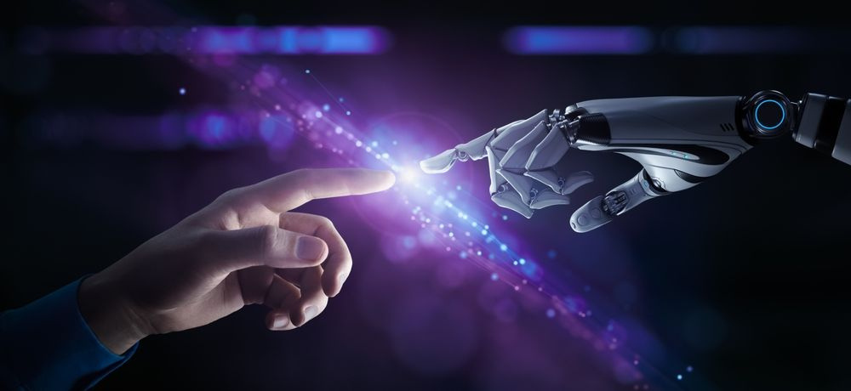
02
Movement 2:
The Track On Demand
Cycle 4
In Cycle of Reflection 4,
The Human Singularity in the Age of the Techno Singularity, my insights were:

Slide 6

02
Movement 2:
The Track On Demand
Cycle 5
In Cycle of Reflection 5,
Corporate Culture in times of Rapid Tech Change, my insights were:

Slide 7
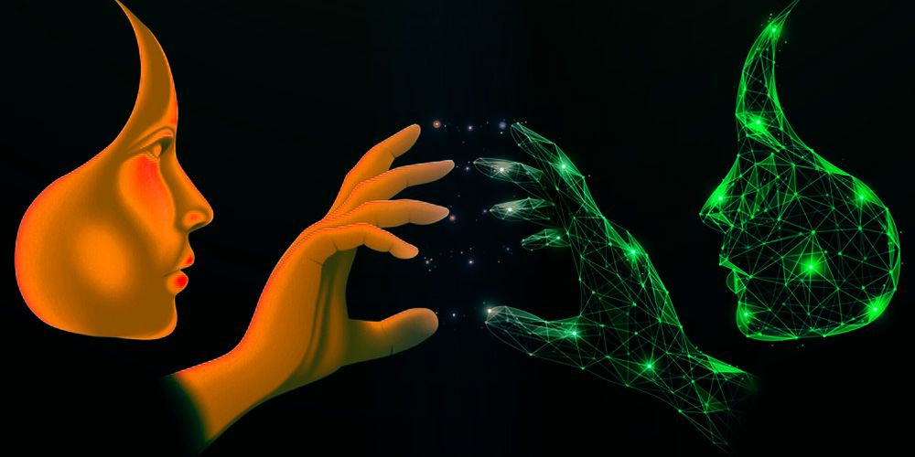
02
Movement 2:
The Track On Demand
Cycle 6
In Cycle of Reflection 6,
Panel on the Future is High-Tech,
my insights were:

Slide 8
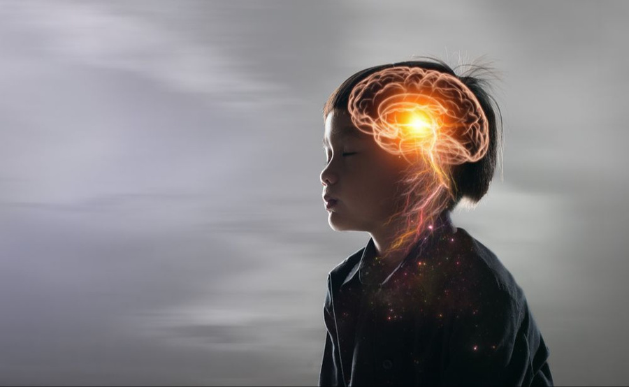
02
Movement 2:
The Track On Demand
Cycle 7
In Cycle of Reflection 7,
What is Science Telling us about the Brain & Awareness
my insights were:

Slide 9
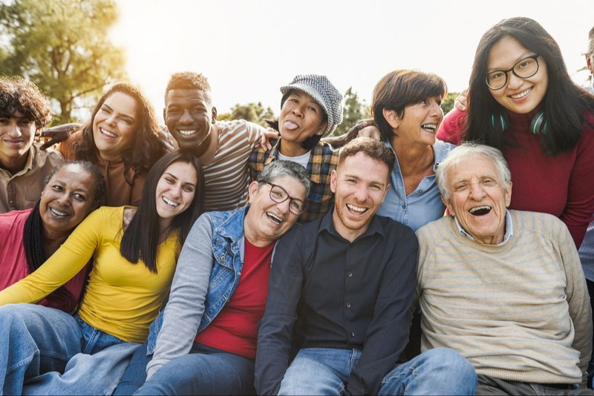
02
Movement 2:
The Track On Demand
Cycle 8
In Cycle of Reflection 8,
How to Build Coherence from Diverse Generational Perspectives? my insights were:

Slide 10
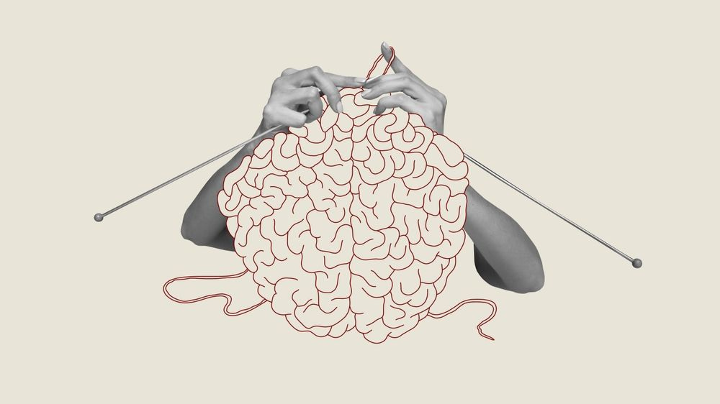
02
Movement 2:
The Track On Demand
Cycle 9
In Cycle of Reflection 9,
Neuroscience of Leadership,
my insights were:

Slide 11

02
Movement 2:
The Track On Demand
Cycle 10
In Cycle of Reflection 10,
Panel on The Self is High-Wisdom,
my insights were:

Slide 12
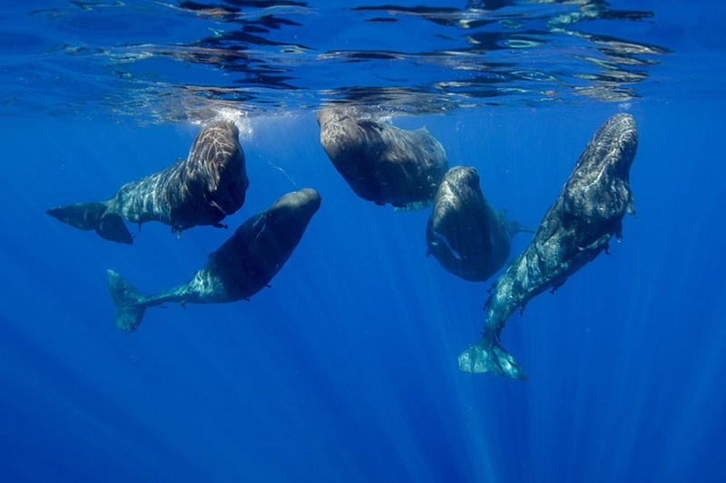
02
Movement 2:
The Track On Demand
Cycle 11
In Cycle of Reflection 11,
Words Driving Worldviews & Innovation,
my insights were:

Slide 13

02
Movement 2:
The Track On Demand
Cycle 12
In Cycle of Reflection 12,
Understanding Complexity to Unleash Creativity,
my insights were:

Slide 14
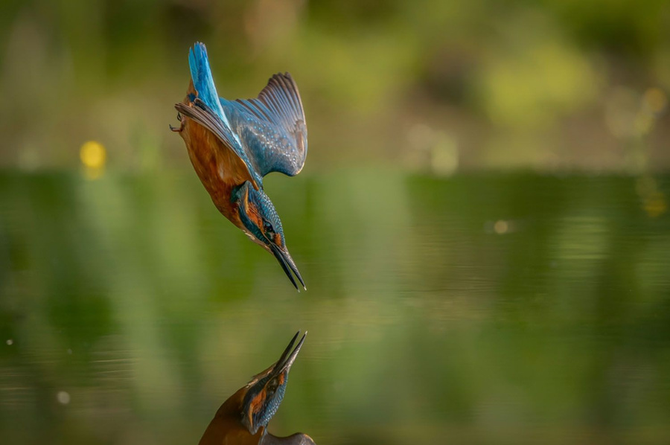
02
Movement 2:
The Track On Demand
Cycle 13
In Cycle of Reflection 13,
Setting New Lens with Biomimicry,
my insights were:

Slide 15

02
Movement 2:
The Track On Demand
Cycle 14
In Cycle of Reflection 14,
Panel on Innovation is Nature-Positive,
my insights were:

Slide 16
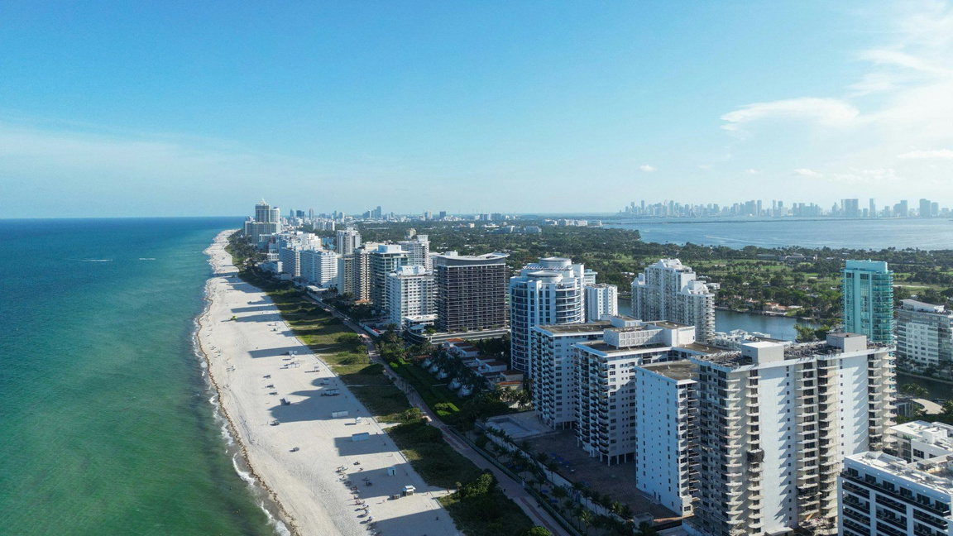
02
Movement 2:
The Track On Demand
Cycle 15
In Cycle of Reflection 15,
Case Study onThe City of Miami,
my insights were:

Slide 17
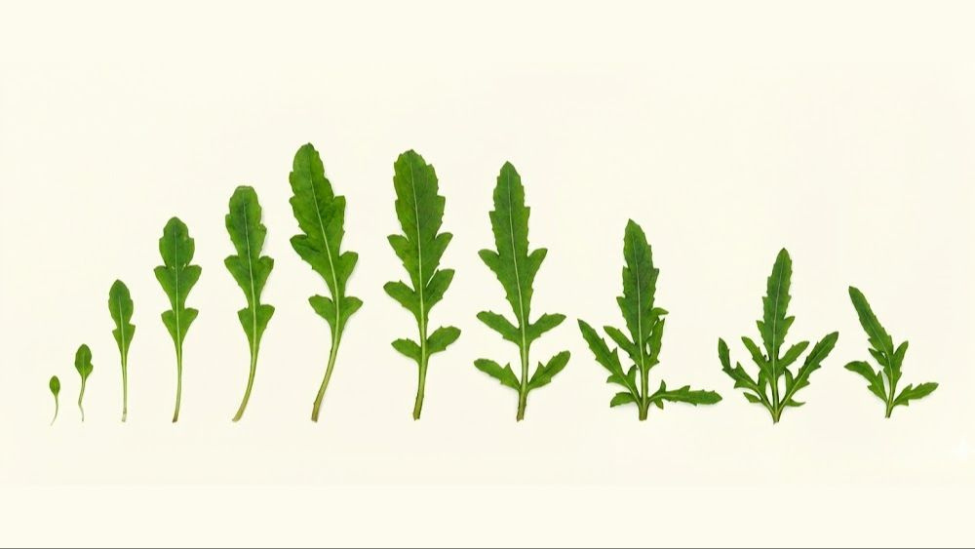
02
Movement 2:
The Track On Demand
Cycle 16
In Cycle of Reflection 16,
Words of Wisdom, my insights were:

Slide 18

02
Movement 2:
The Track On Demand
Cycle 17
In Cycle of Reflection 17,
Leadership Forum Miami, my insights were:

Slide 19
03
Movement 3:
LIVE Group Practice
At the end of the first round through
the 17 Cycles of Reflection and learning together as a cohort I see that my quest …(describe the movement and the result. Add a picture if you wish)

Slide 20
04
Movement 4:
Community & Legacy
My next movement will be…
(describe what you wish to do next with what you have learned and how you intend to continue to follow your journey at Briyah)

